Slide 1
Financing A College Education
2022-2023
Financial Aid, Scholarships,
and more
Notes:
‹#›

Slide 2
Topics in Presentation
Goal of Financial Aid
FAFSA
Description of Financial Aid Programs
Timelines
Payment options
Other Benefits to Consider
Resources
Notes:
‹#›

Slide 3
Goal of Financial Aid
Goal of Financial Aid: Assist students by evaluating family’s ability to pay for education, distribute limited resources in an equitable manner for an academic year.
FAFSA 2022-2023 (Free Application For Federal Student Aid) is the key.
FAFSA calculates SAI (Student Aid Index) and determines financial need
Apply annually
Notes:
‹#›

Slide 4
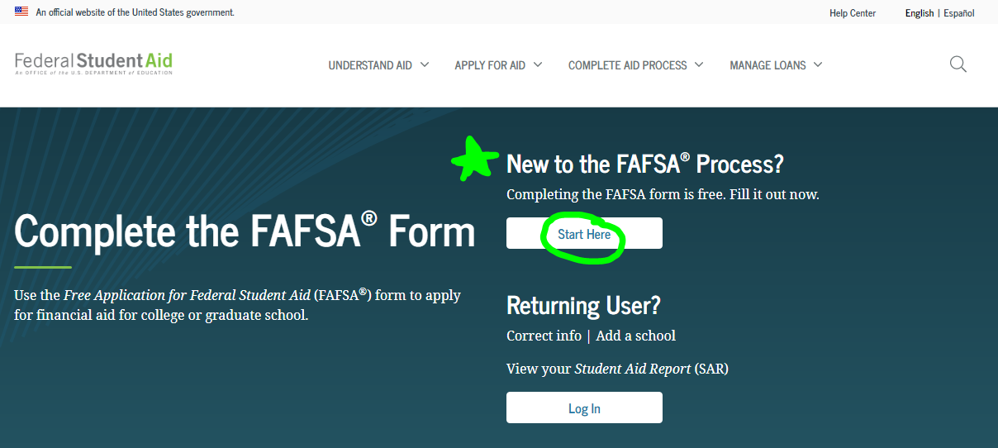
FAFSA
Available online at
Website: https://studentaid.gov/h/apply-for-aid/fafsa
after October 1, 2021
Or with mobile app:
myStudentAid (for Android and iOS)
Notes:
‹#›

Slide 5
Definition of Need
Cost of Attendance (COA)
- Student Aid Index (SAI)
= Financial Need/Eligibility
* College Net Price Calculator on college website OR
* Estimated EFC calculator at www.ohe.state.mn.us OR
https://studentaid.gov/aid-estimator/
Notes:
‹#›

Slide 6
Cost Of Attendance
Tuition and Fees
Room and Board
Books and Supplies
Transportation and miscellaneous personal
expenses/computer, etc.
Loan Fees
Study Abroad Costs
Notes:
‹#›

Slide 7
FAFSA: Seven Components
Student Demographic Information
* Need SSN, Drivers License, 2020 tax returns, real time asset information
School Selection
* List up to 10 different schools
Notes:
‹#›

Slide 8
FAFSA: Continued…
3. Dependency Status
Born before Jan 1, 1999
Graduate or professional student
Student is Married/Separated
Has legal dependents other than spouse that receive more than 50% financial support from student
Orphan/ward of the court/emancipated minor/legal guardianship/homeless
Veteran of or currently serving on active duty in US Armed Forces
Determined to be independent by FA office
Notes:
‹#›

Slide 9
FAFSA: Continued…
Parent Information
Parent(s) name, date of birth, social security number
Marital Status
Married – If biological/adoptive parents married, report information for both parents on FAFSA
Unmarried, but living together - If biological/adoptive parents are not married, but living together, regardless of gender, report information for both parents on FAFSA
Divorced/Separated – If biological/adoptive parents are divorced/separated, provide information for parent:
Student lived with the most in last 12 months
Or, if lived equal periods with each parent, parent who provided the most financial support in last year or most recent year support provided
*If parent remarried, include stepparent information.
Number in family/college
Notes:
‹#›

Slide 10
FAFSA: Continued…
Financial Information
- Use parent & student 2020 taxes and real time asset
information
- IRS Data Retrieval Tool – real time tax information
transfer to FAFSA from IRS
- Optional, but recommended
- Increased security/confidentiality, encrypted tax information
- Able to manually adjust IRA rollovers/pension distributions to remove
from calculation
- Assets: student, parent
Notes:
‹#›

Slide 11
FAFSA Continued
Investments
Must report:
529 College savings plans Mutual Funds
Trust Funds UGMA/UTMA accounts
Money markets Stocks & Stock Options
CD’s Coverdell savings accounts
Real Estate (lake home, rental property, etc.)
Do not report:
Home you live in Value of life insurance
Retirement plans Family Farm
Business you own with 100 or less FT employees
Notes:
‹#›

Slide 12
FAFSA: Continued . . .
Sign & Submit
- Apply for FSA ID (create username and password)
- https://studentaid.gov/fsa-id/create-account/launch (today)
- Need a FSA ID for a parent AND for the student
- FSA ID is used for:
-signing FAFSA
-make FAFSA corrections
-signing federal loans
-look up student loan history
Notes:
‹#›

Slide 13
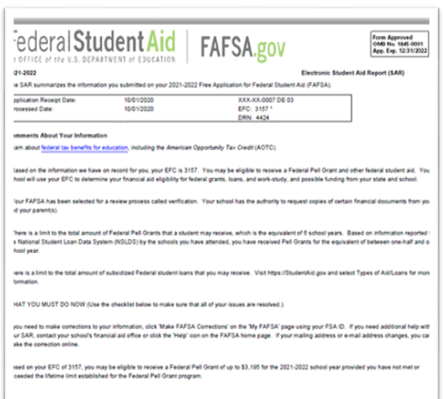
FAFSA: Continued . . .
Confirmation
- Student Aid Report (SAR) review/make
corrections. Available at www.studentaid.gov
- Verification selection
- Renew FAFSA each year
- Special Circumstances
-employment changes/loss of job
-medical expenses
-parent enrolled in college, etc.
Notes:
‹#›

Slide 14
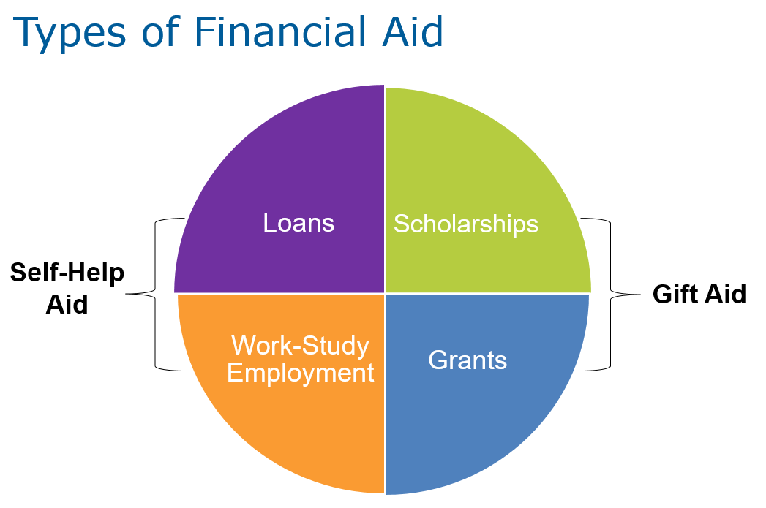
What is Financial Aid?
Notes:
‹#›

Slide 15
Gift Aid
Grants
Institutional/College
State
Minnesota State Grant: $100 - $12,949*
More MN grants/scholarships at ohe.state.mn.us
Federal
PELL Grant: max award = $6495*
SEOG: awards range between $100 - $4000*
Iraq & Afganistan Service Grant : not to exceed COA
TEACH Grant: $4000* for students majoring in education, designated areas of teaching, turn into loan if do not teach after college.
*Based on 2021-2022 award amounts.
Notes:
‹#›

Slide 16
Gift Aid
Scholarships
Institutional/College Scholarships
School/Local/Civic/Community Scholarships
National Scholarships
Search the Web ~ Fastweb.com
Parent/Student place of employment
*Deadlines - winter/spring of senior year
Notes:
‹#›

Slide 17
Scams
Never pay for scholarship or scholarship applications
Fin Aid Seminars/Consultants: must sign fafsa
DO NOT USE!!! www.fafsa.com OR fafsa-application.com
**Never pay to complete the FAFSA, it’s free!
Contact a financial aid or guidance office for advice if you’re uncertain.
Notes:
‹#›

Slide 18
Self-Help Aid
Loans
Federal Direct Loan Program:
* subsidized: 3.73%, no interest accrual (2021-2022)
* unsubsidized: 3.73%, accrues interest (2021-2022)
-$5500 sub & unsub combination (first-year)
-$6500 sophomore
-$7500 junior
-$7500 senior
SELF Loan: 2.2% variable or 4.85% fixed
Alternative/Private Loan: 1.25% - 12.99%, variable & fixed options available, credit-based
Federal Direct PLUS Loan: 6.28% fixed rate, credit-based (2021-2022)
Notes:
‹#›

Slide 19
Self-Help Aid
Student Employment/Work Study
- Funding Sources
Federal
State
Institution
- Guaranteed?
- On versus Off Campus
Notes:
‹#›

Slide 20
Time Line
* Apply and be admitted to colleges/universities - NOW
* Research and apply for scholarships - NOW
* Complete your FAFSA after October 1, 2021
(*** Use the IRS DRT to transfer your 2020 tax information)
* FAFSA processing will take about 2 days then able to review SAR and results available to schools you listed with in 10- 14 days.
Check with each school to determine financial aid deadlines and if additional forms are needed for a complete financial aid file.
* Compare Award Offers – “apples to apples”
Notes:
‹#›

Slide 21
Payment Plans
Installment plans
Semester plan
Others ~ check with schools to which you are applying.
Notes:
‹#›

Slide 22
Other Benefits to Consider
American Opportunity Tax Credit
Lifetime Learning Tax Credit
Student Loan Interest Deduction
Employer-Paid Tuition Assistance
Military Service Education Benefits ohe.state.mn.us
Tuition Reciprocity ohe.state.mn.us
WI, ND, SD, Manitoba, IA Lakes CC
Midwest Student Exchange Program
(IL, IN, KS, MO, NE) ohe.state.mn.us
** Always check with your tax preparer!
Notes:
‹#›

Slide 23
Popular Web Sites
studentaid.gov/h/apply-for-aid/fafsa FAFSA
studentaid.gov/fsa-id/create-account/launch FSA ID website
studentaid.gov US Dept of Ed Financial Aid Info
ohe.state.mn.us State of Minnesota/Scholarships/VA
fastweb.com Scholarship Search
finaid.org Financial Aid Info/Scholarships
collegeboard.org PROFILE application & Scholarships
Notes:
‹#›

Slide 24
Questions?
How to contact me:
Cheryl Dooley
Associate Director Financial Aid
Hamline University
cdooley@hamline.edu
651-523-3000 or 1-800-888-2182
Notes:
‹#›

